Slide 1
Tools used in Data Science
Tomas Karpati MD
tc.datascience@gmail.com
054-2002430

Slide 2
Tools Used in Data Science
Managing the working environment
Managing the working system
Virtual environment
Git & Github
Managing Data
Data sources
Files
Relational Databases
Big data

Slide 3
Virtual Environments
What is a virtual environment?
Is an isolated environment that is intended to preserve the dependencies of the programs/libraries needed for a project.
Virtual environments (VE)
Program-specific library based VE
pipenv / virtenv (python)
packrat (R)
OS-based containers
Docker
OS virtualization
VMWare
VirtualBox
QEmu
Virtual Machine
Docker
dist-packages
dist-packages
Pyhon
pipenv
Pyhon
OS libraries
dist-packages
OS libraries
vOS
dist-packages
dist-packages
dist-packages
Pyhon
Pyhon
Pyhon
OS libraries
OS libraries
OS libraries
Host OS (Linux / Windows / Mac)

Slide 4
Python Virtual Environment
Creating a new project using a virtual environment
First we need to install pipenv if it is not yet installed:
> pip install pipenv (or sudo pip install pipenv in linux)
Now create a new directory and enter it
> mkdir project1; cd project1
Lets install the needed package we want to work with
> pipenv install pandas
The module will be installed in the project1 directory and two files will be generated: Pipfile and Pipfile.lock which contain all the needed dependencies for the project.
To install the dependencies we run:
> pipenv install requirements.txt
To enter the virtual environment we type:
> pipenv shell
> python

Slide 5
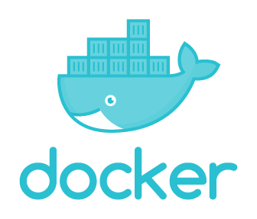
Docker
Steps to create a new docker:
Select a docker template from the docker hub.
Create a new directory with a ‘Dockerfile’ file.
Change to the new directory >cd ./my_new_dir
Build the new image >docker build -t <docker_name> .
Initialize the new docker: >docker run -it -p 8888:8888 <docker_name>:latest
Steps to download a docker image:
Select a docker image from the docker hub.
Download the docker image: >docker pull <creator>/<image>
Initialize the new docker: >docker run -it -p 8888:8888 <docker_name>:latest

Slide 6
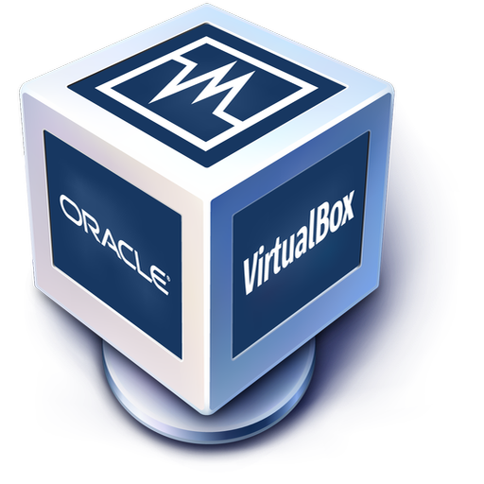
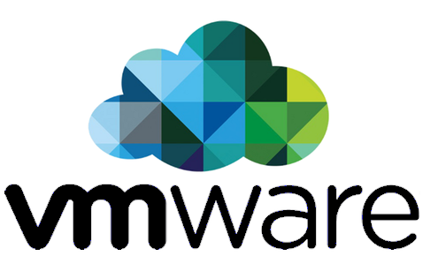
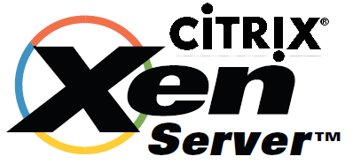
Virtual Machines
Virtual Machines (VM) run on the original OS (host OS)
The VM software emulate the hardware and gives the client OS limited access on the host hardware.
The client OS is isolated from the host OS.
On one real machine can run any number of VMs. The restrictive factor is CPU, memory and disk capacity.
VMs can be launched and dropped dynamically when needed.
VMs are resource demanding

Slide 7
Github
Linus Torvalds - While working in Linux development feel the need for a system that is:
Simple
Intuitive but powerful way to store the code
Work with multiple version
Ability to go back if things go wrong
Existent solutions were not good enough good for his needs and standards
He created Git!

Slide 8
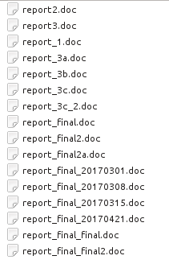
Why Version Control?

Slide 9
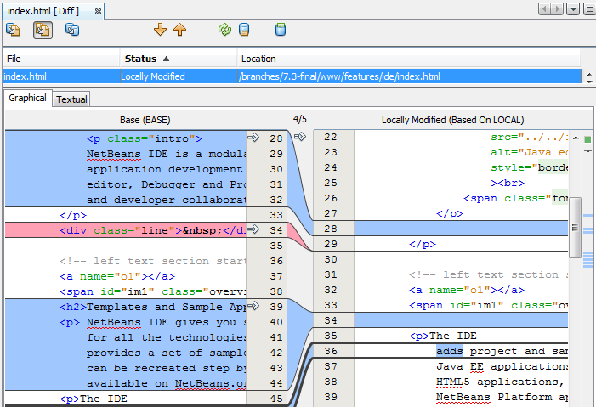
Why Version Control?

Slide 10
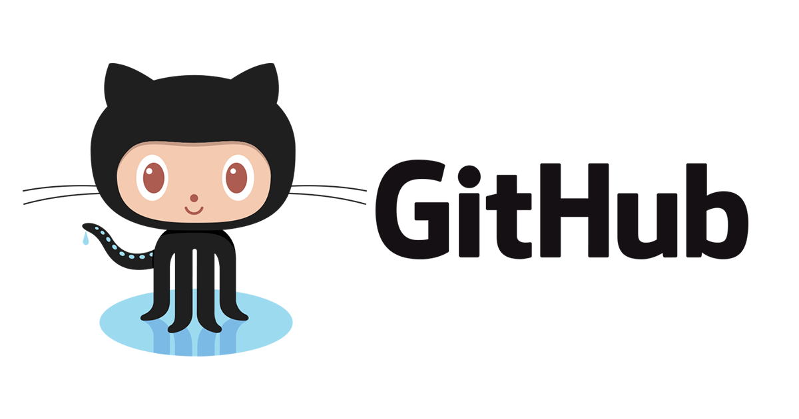
Github

Slide 11
Git
Setup
Clone
Local
Server
Global Setup
git config --global user.name “Israel Israeli”
git config --global user.email “isreali@isp.com”

Slide 12
Git
Setup
Clone
Local
Server
Clone an existing repository
git clone https://github.com/karpatit/DataScience.git
cd DataScience

Slide 13
Git
Setup
Clone
Local
Server
Create a local repository
> mkdir myproject
> cd myproject
### after adding some files...
> dir myproject
code.py
README
> git init .
> git add .
> git commit -m “initial commit”
> git push -u origin master (*)

Slide 14
Git
Setup
Clone
Local
Server
Sync local repository with a remote one
cd myproject
git remote add origin https://github.com/karpatit/DataScience.git
git pull
git push -u origin --all

Slide 15
Git
Your turn:
Create a Github account
Clone the “DataScience” repository
(https://github.com/karpatit/DataScience)
Move to the local copy of DataScience
Create a git (local) and github (remote) repository for this folder
Add some files (SQL homework)
Commit your changes
Push your local repository to your github account

Slide 16
> git remote set-url origin https://github.com/xxxxx/DataScience.git
> git add .
> git commit -m “first commit”
> git pull
> git push -u origin master

Slide 17
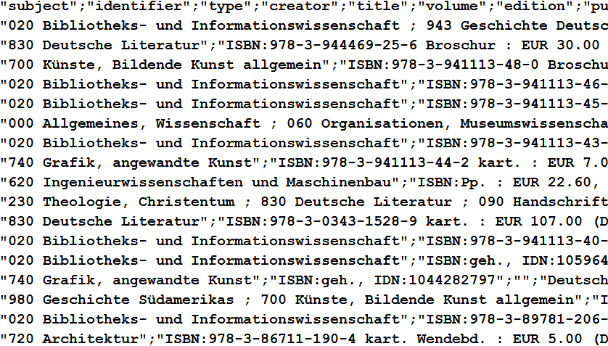
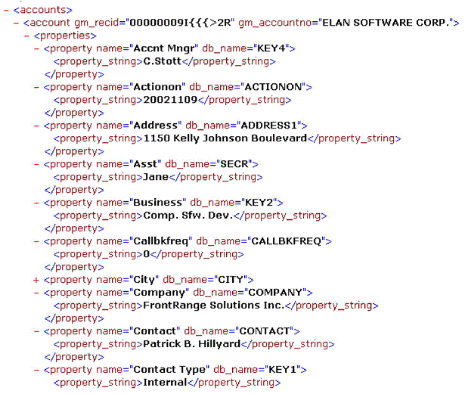
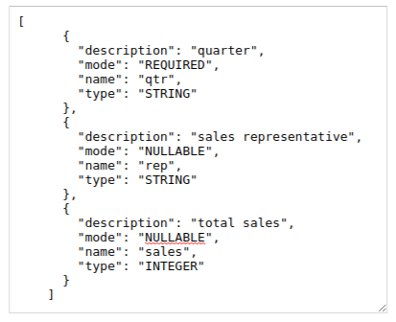


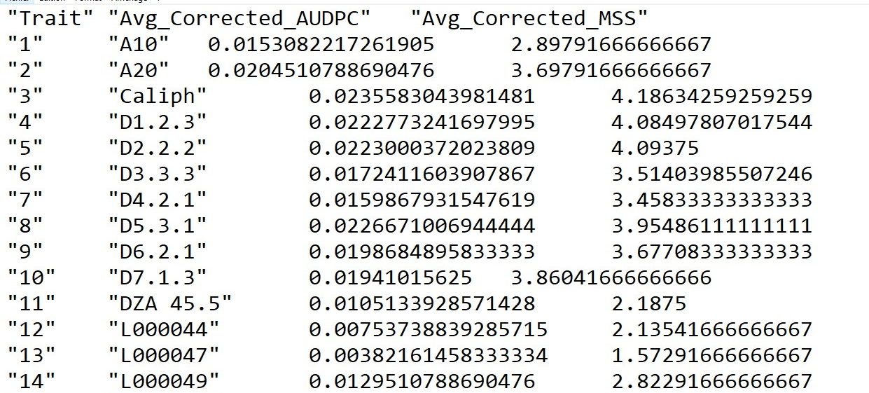


Managing Data
Files:
Delimited text (TAB, CSV)
Excel
Json
SAS
SPSS
Markup language:
HTML
XML

Slide 18
Managing Data
Industrial standards for data exchange:
MISMO: Mortgage Industry Standards Maintenance Organization
FpML: Financial products Markup Language (B2B)
NDC: New Distribution Capability (travel)
OTA: OpenTravel Alliance (travel)
HL7: Health Level 7 (healthcare)

Slide 19
Managing Data
Databases
Relational: MSSQL, MySQL, Oracle, DB2, PostgresSQL
Column Based: MonetDB, C-Store, Teradata, Vectorwise/ Paraccel, Sybase IQ, InfiniDB, Vertica
Time-Series: eXtremeDB, Graphite, InfluxDB, TimescaleDB, OpenTSDB
GraphDB: Neo4j, Neptune (Amazon), InfiniteGraph

Slide 20
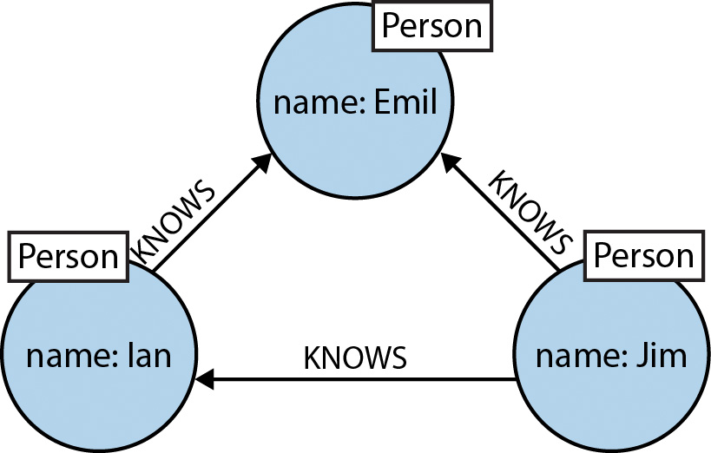
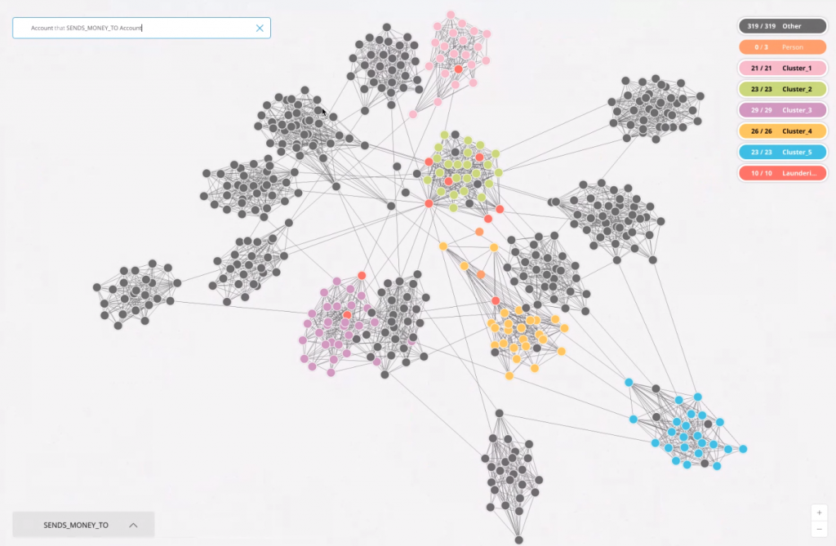
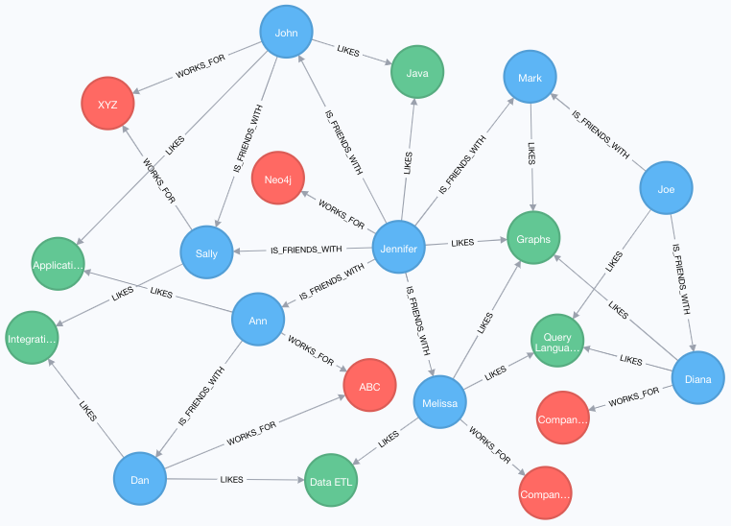
Managing Data
Graph Databases

Slide 21
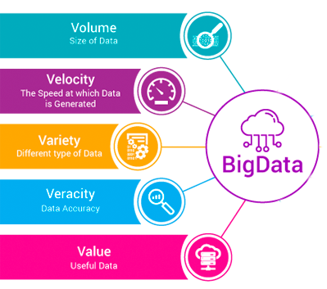

Big Data
Notes:
חוזקות ובעיות של ביג דאטה

Slide 22
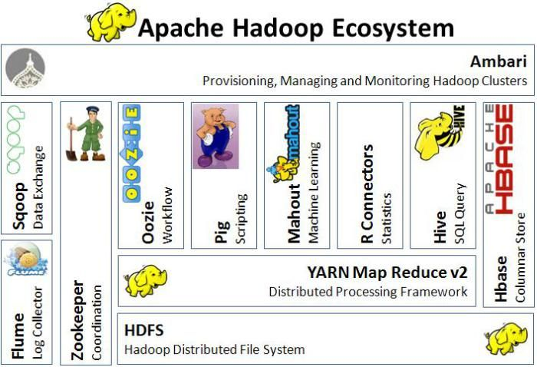
Hadoop
Notes:
חוזקות ובעיות של ביג דאטה

Slide 23

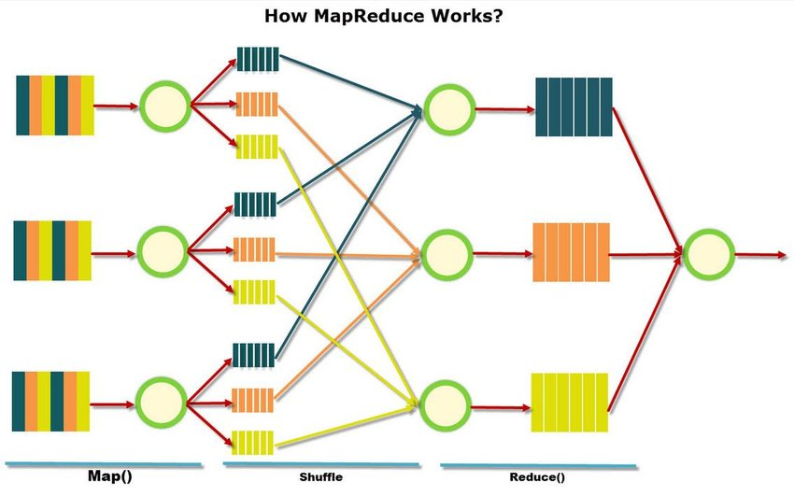
MapReduce
Notes:
חוזקות ובעיות של ביג דאטה

Slide 24
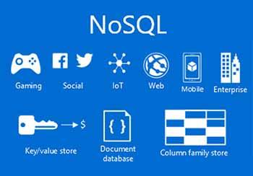
NoSQL
NoSQL (non-SQL, non-relational) database provides a mechanism for storage and retrieval of data that is modeled in means other than the tabular relations used in relational databases.
Notes:
חוזקות ובעיות של ביג דאטה

Slide 25
NoSQL Storage Types
Many alternatives exist (115+):
Key-value store,
Document store,
Graph,
Object database,
Tabular,
Tuple store,
Triple/quad store (RDF),
Hosted (Amazon, Google, Microsoft),
Multivalue databases,
Multimodel database
Notes:
חוזקות ובעיות של ביג דאטה

Slide 26
NoSQL Storage Types
BEST NOSQL DATABASES 2018-19
MongoDB (OSS)
Cassandra (Apache, OSS)
Redis
Hadoop/HBase (Apache, OSS)
Neo4j (OSS)
Oracle NoSQL
Amazon DynamoDB
Couchbase (OSS)
Memcached (volatile, on-RAM)
CouchDB (json)
Based on: https://www.improgrammer.net/most-popular-nosql-database/
Notes:
חוזקות ובעיות של ביג דאטה

Slide 27
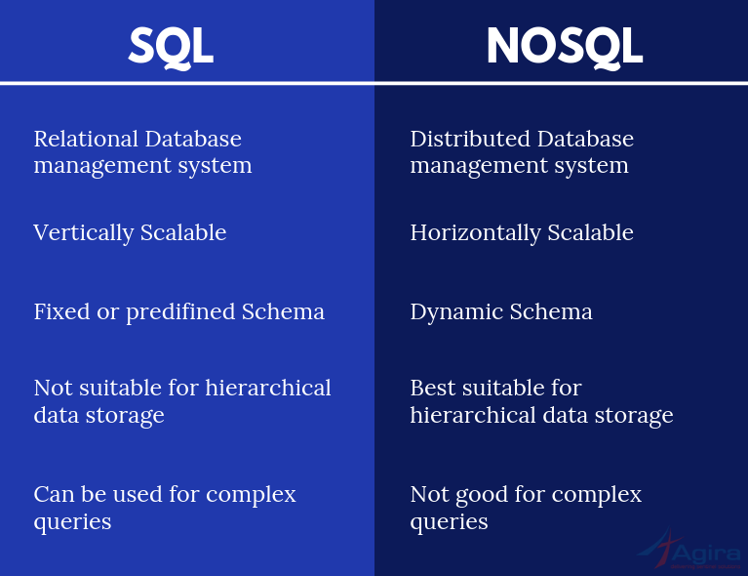
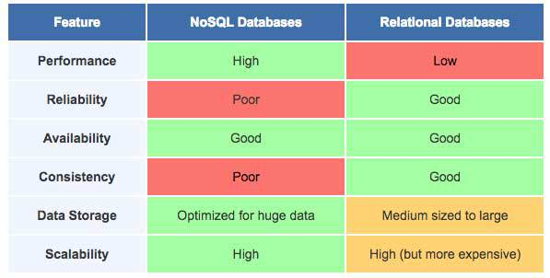
NoSQL vs SQL
Source: https://pandorafms.com/blog/nosql-databases-the-definitive-guide/
Source: https://www.agiratech.com/the-key-differences-between-sql-and-nosql-database/
Notes:
חוזקות ובעיות של ביג דאטה

Slide 28
Setting up Jupyter Notebook
Enter the Linux server: from the program putty initiate an SSH session with the server’s username and password
Clone your own repository on the server
git clone https://github.com/<yorusername>/DataScience.git
Enter the python folder and run Jupyter notebook
notebook password
python notebook
Open the Chrome browser and enter your assigned address:
http://192.168.1.1:99XX
Enter the server’s password to enter the notebook
Notes:
חוזקות ובעיות של ביג דאטה

